Slide 1
University Physics I
January 2022– June 2022
Teacher: Dr. Paul Briard
Email: paulbriard@outlook.com
Wechat: Paulbg123

Slide 2
Lecture in English !
Why teaching you using English language ?
A good practice !
It doesn’t matter if you understand 10% of what I say (sorry for my bad microphone !).
All the important information are on the ppt (I send by wechat the ppt after each lecture).

Slide 3
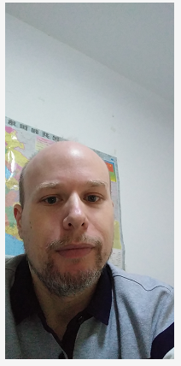
Self-introduction
2005-2007: High school/middle school teacher in Physics-Chemistry

Slide 4
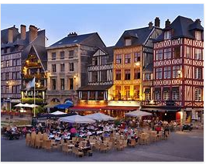

Self-introduction
2005-2007: High school/middle school teacher in Physics-Chemistry
2007- 2012: Master Degree and PhD (university of Rouen and Insa of Rouen, France)

Slide 5
Self-introduction
2005-2007: High school/middle school teacher in Physics-Chemistry
2007- 2012: Master Degree and PhD (university of Rouen and Insa of Rouen, France)
2013- May 2018: Post-doctoral Student at Xidian and at USST (Shanghai)
Since May 2018: Assistant Professor at Xidian

Slide 6
Self-introduction
2005-2007: High school/middle school teacher in Physics-Chemistry
2007- 2012: Master Degree and PhD (university of Rouen and Insa of Rouen, France)
2013- May 2018: Post-doctoral Student at Xidian and at USST (Shanghai)
Since May 2018: Assistant Professor at Xidian
Field of research: Optics and light scattering by particles (mainly theory/computing)

Slide 7
Purpose of the lecture
to give you a good background in Physics, in various topics
to practice your skills of solving Physics problems (and do calculation, so please to buy a calculator if you don’t have)
See more deeply what you have learned in high-school
To improve your understanding of physical phenomena, and understanding of things such as:
What is energy ?
What is the light ?
What is the heat ?
And so on …

Slide 8
Homework
I will give you homework to do every wednesday night, by wechat.
The Monday of the next week, you give back the homework (you will upload it on the website I will give you on our wechat group).
There will be not a score given for every homework. Homework is to help you to practice. Cheating is meaningless (and I hate cheating).

Slide 9
Please to avoid these things:
Speaking at the same time than me during the lecture. This is very disturbing.
Coming late in classroom.
Sleeping during the lecture …
Well, for the online lecture, this doesn’t matter, but keep it mind when I will teach you in classroom …

Slide 10
Exercises in classroom …
During the lecture (including online lectures, please to prepare a paper and a pen), I will give short exercises of 5-10 minutes to do.
Before to check the solution, I ask a student to solve the exercise at the blackboard.
I choose the student who is the less focused by the lecture, so … ☺

Slide 11
Exercises in classroom …
During the lecture (including online lectures, please to prepare a paper and a pen), I will give short exercises of 5-10 minutes to do.
Before to check the solution, I ask a student to solve the exercise at the blackboard.
I choose the student who is the less focused by the lecture, so … ☺
Well, for the online lecture, this doesn’t matter, but keep it mind when I will teach you in classroom …

Slide 12
Score and examinations
One middle examination and one final examination for each semester.
Both are part of the total score, around:
25%: homework/assiduity
25%: middle examination
50%: final examination
assiduity: you have to come to every lectures, excepted if you have a good reason, for instance, you are sick and you are at hospital.

Slide 13
Rules for middle and final examinations
Chinese-English dictionary allowed.
Only calculator without memory is allowed.
You must remember the equations needed to solve the exercises (the homework will permit you to see that and I will say you when an equation is important).
The constants will be given on the examination paper (excepted few cases I will say you later)

Slide 14
Advices for middle and final examinations
You should prepare them along the semester, don’t wait the week before them to prepare.
With me, you do only one half of the work.
The other half is to practice by yourself.

Slide 15
Contents of the lecture University Physics I
Mechanics (Newtonian/classical mechanics)
Optics (geometric optics and wave optics)
Heat Transfers
Contents of the lecture University Physics II
4. Static electric field, Static magnetic field
5. Electromagnetic induction
6. Introduction to Modern Physics (Quantum Physics, special relativity)

Slide 16
University Physics I, part 1: Classical mechanics
February 2021– June 2021
Teacher: Dr. Paul Briard
Email: paulbriard@outlook.com
Wechat: Paulbg123

Slide 17
A word about units
Most scientists and engineers (and we) use the “International System of units” (named also “SI units”),
Here are some base SI units, you certainly already know:
meter (symbol: m), SI unit of the length
kilogram (symbol: kg), SI unit of the mass
second (symbol: s), SI unit of the time
Kelvin (symbol: K), SI unit of the temperature
…
Here are some derived SI units:
Newton (symbol: N), SI unit of the force
Joules (symbol: J), SI unit of the energy
Pascal (symbol: Pa), SI unit of the pressure
…
Sometimes, it could be more convenient to use other units, for instance to express a distance between two stars in light-year rather than in meter !

Slide 18
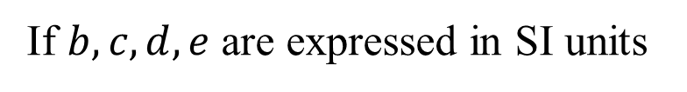
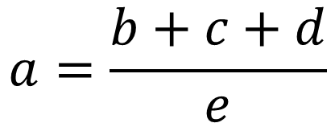

A word about units
When you do a calculation for a problem, if all the variables used for calculation are in SI units, your result will be also in SI unit
$$a=\frac{b+c+d}{e}$$
Example:
If $b,c,d,e$ are expressed in SI units
Then the variable $a$ calculated is also in SI unit

Slide 19
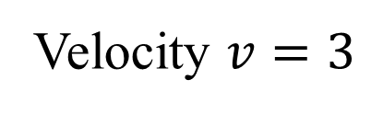

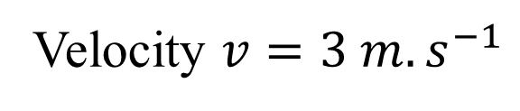
A word about units
Checking the units
Checking the units permits to see mistakes in your calculations, for instance:
You calculate a velocity (i.e. a speed):
The result must be in unit: $m.s^{−1}$
A calculation result without unit is meaningless !
!
Velocity $v=3$
Velocity $v=3 m.s^{−1}$

Slide 20
Chapter 1: Kinematics of a particle
§1-1 Position vector of a particle
§1-2 Displacement, Velocity, Acceleration
§1-3 Acceleration in intrinsic coordinates
§1-4 The circular motion
§1-5 the motion is relative
As you can see, this chapter is simply a reminder of what you have seen in high school, which could be quite useful.

